Slide 1


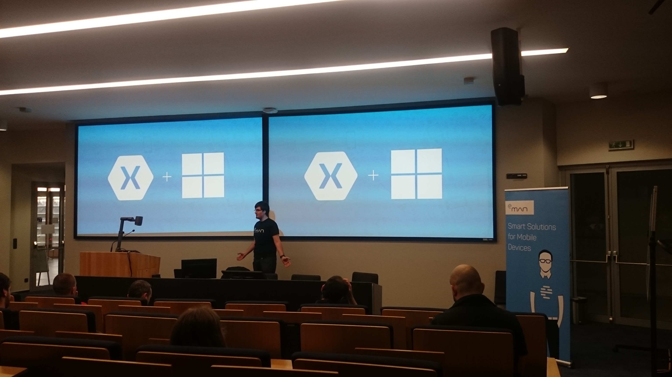
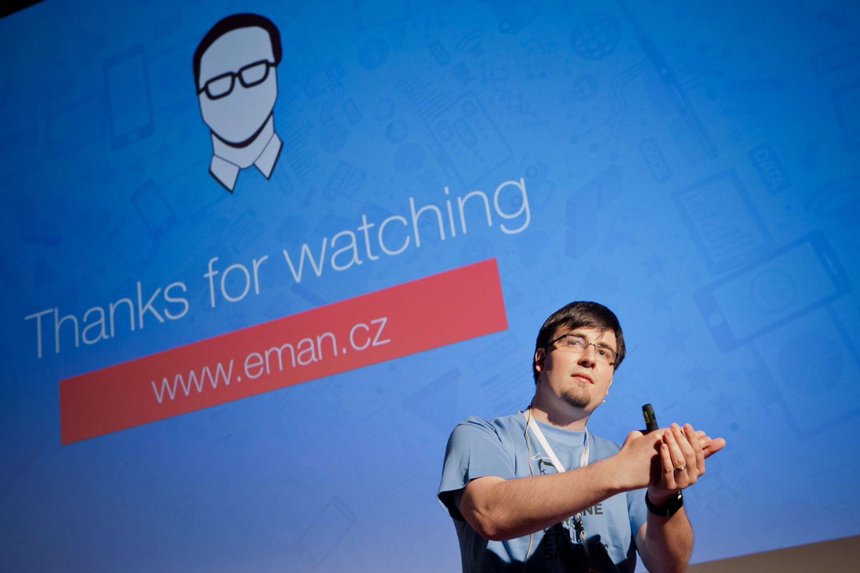
Mobile Center and VSTS
XMDG Czech
Vojtěch Mádr
madrvojt.wordpress.com
@madrvojt
Microsoft & Xamarin MVP, Senior Xamarin Developer at Worklio

Slide 2
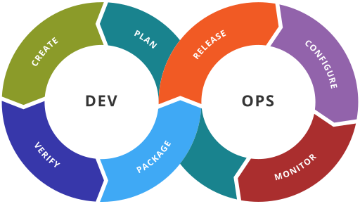
What is DevOps?
XMDG Czech
DevOps is a culture, movement or practice that emphasizes the collaboration and communication of both software developers and other information-technology (IT) professionals while automating the process of software delivery and infrastructure changes

Slide 3
Why DevOps?
XMDG Czech
200x more frequent feature deployments compared to low performers
2555x faster lead times
40% reduction in time to develop, test, and release new applications

Slide 4
Visual Studio Team Services
XMDG Czech
Code
Development and review, version control tools, code merging;
Build
Continuous integration tools, build status;
Test
Test and results determine performance;
Package
Artifact repository, application pre-deployment staging;
Release
Change management, release approvals, release automation;

Slide 5
Visual Studio Team Services
XMDG Czech
Configure
Infrastructure configuration and management, Infrastructure as Code tools;
Monitor
Applications performance monitoring, end–user experience.
Agile
For preparing UserStories, Features, Epic, Backlog etc.

Slide 6
Use Unit tests ! (MSTest, NUnit, XUnit)
Notes:
Android : Co publikujeme ven, je potřeba podepsat ! Ideálně debug certifikát či release SignAndroidPackage

Slide 7
Plugins for Xamarin
XMDG Czech
Core PCL (Bait and Switch)

Slide 8
Create plugins using VSTS

Slide 9
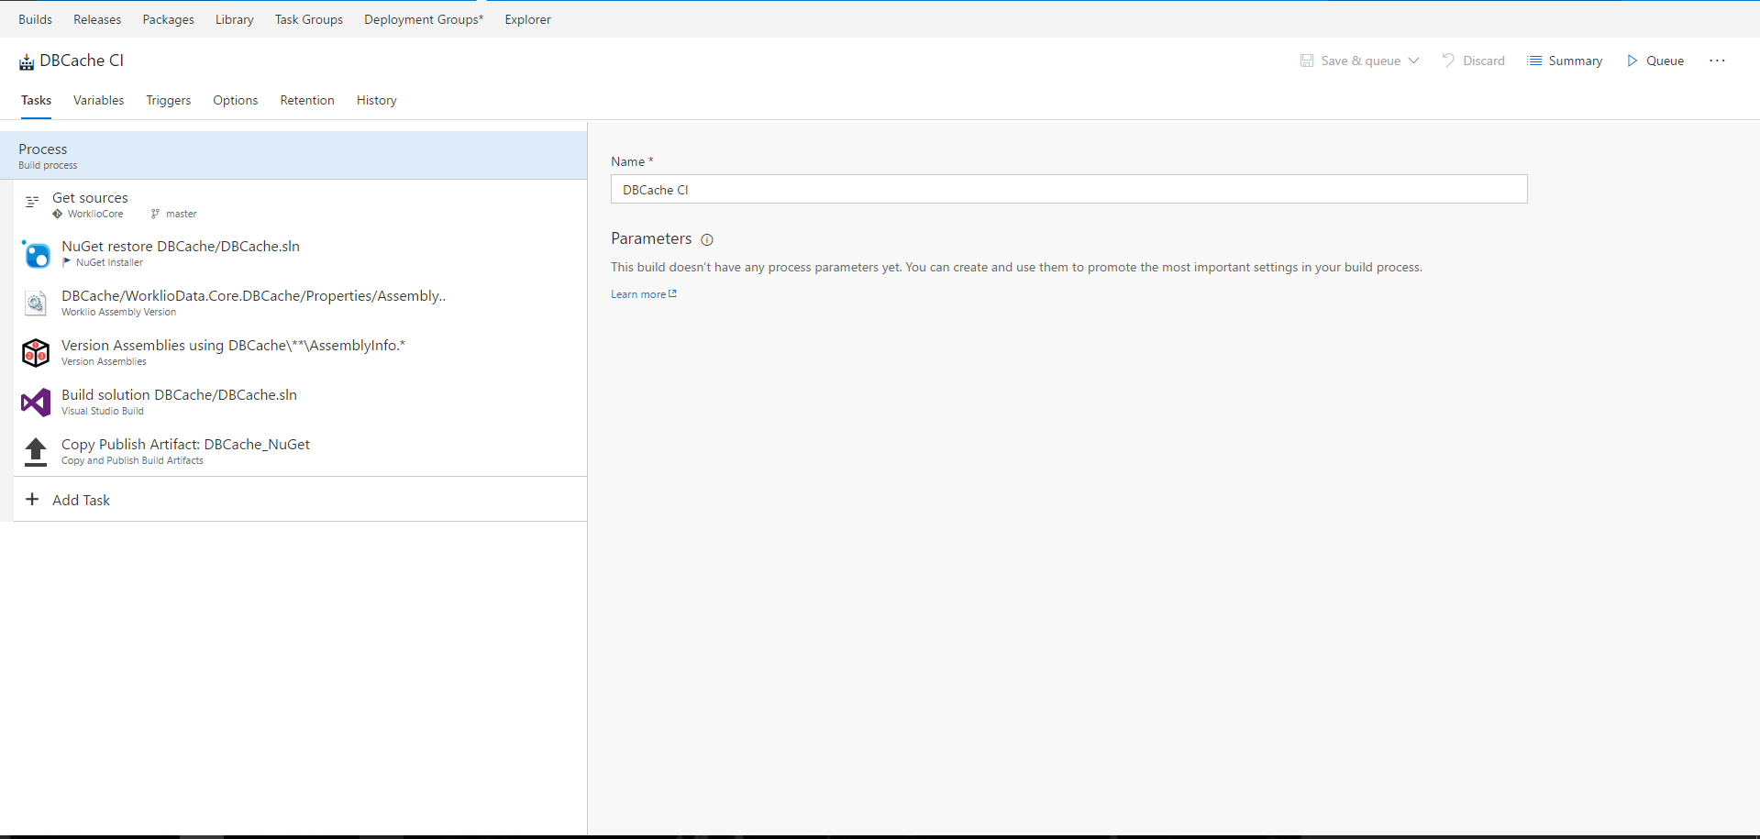
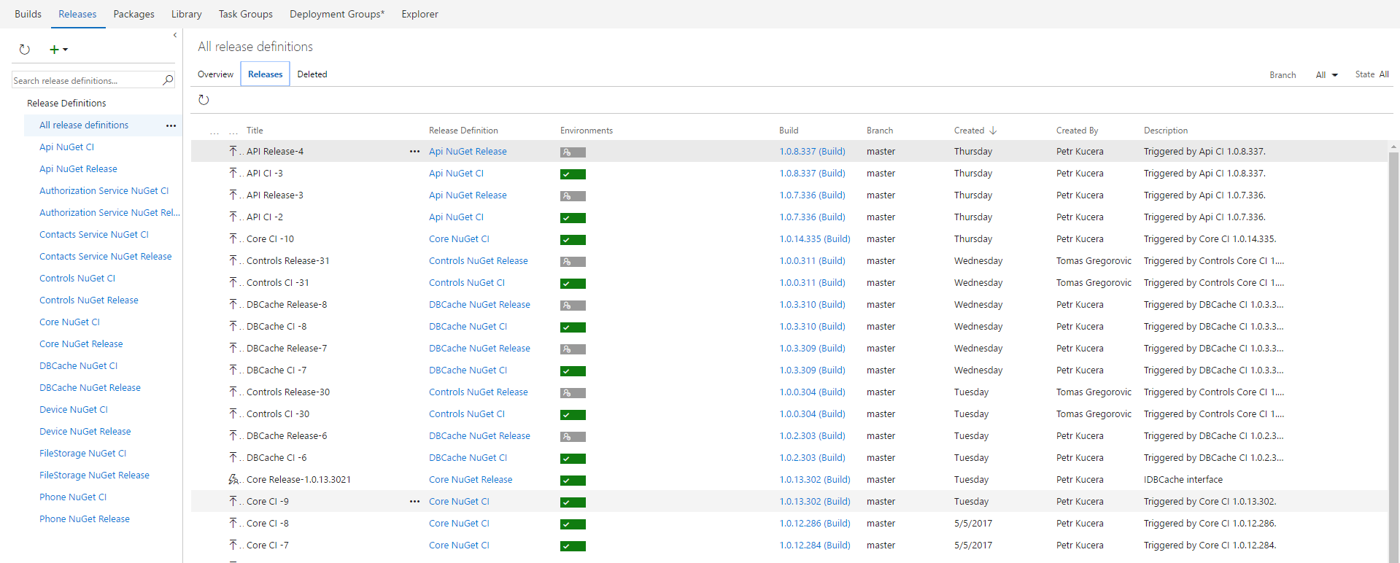
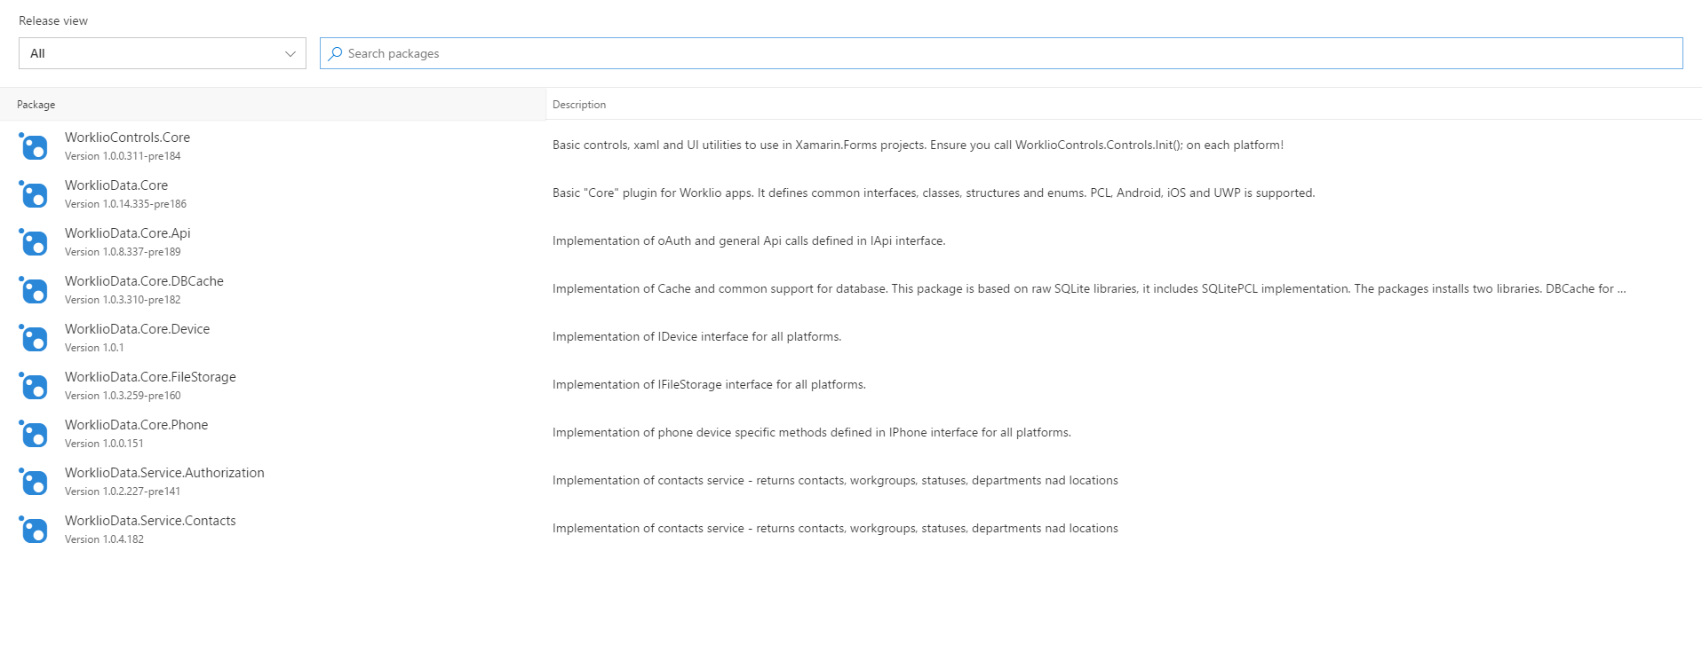
XMDG Czech

Slide 10
Live Update
Crash Reporting
A/B Testing
Storage
Identity
Push Notifications
Remote Config.
Tables

Slide 11
Visual Studio Mobile Center
A/B Testing
Push Notifications
Crash Reporting
Remote Config.
Identity
mobile.azure.com
Tables
Live Update
Storage

Slide 12
Let’s “DevOps” our app

Slide 13
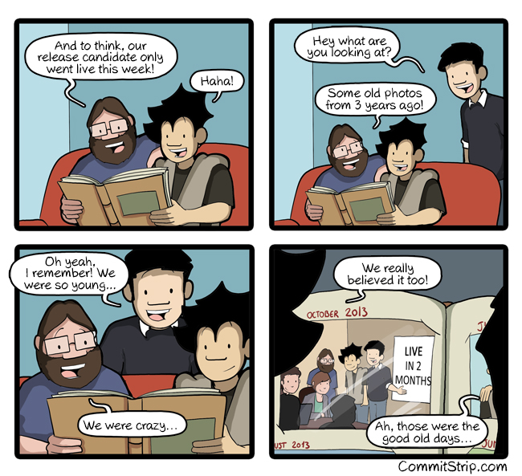
XMDG Czech

Slide 14
Summary
XMDG Czech
Apply DevOps to Mobile Development
Testing your app
Create plugins and use VSTS for “nugeting”
Try MobileCenter and save your time!

Slide 15
XMDG Czech
Thanks for your time!
www.xmdg.cz
twitter : @xmdg_cz
facebook :
DOTNETCZ Podcast - https://soundcloud.com/msimecek/sets/net-cz-podcast
Notes:
So we know what we want how do we get there? Let’s talk about the state of mobile development.

